Slide 1

Vectors Presentation

Slide 2
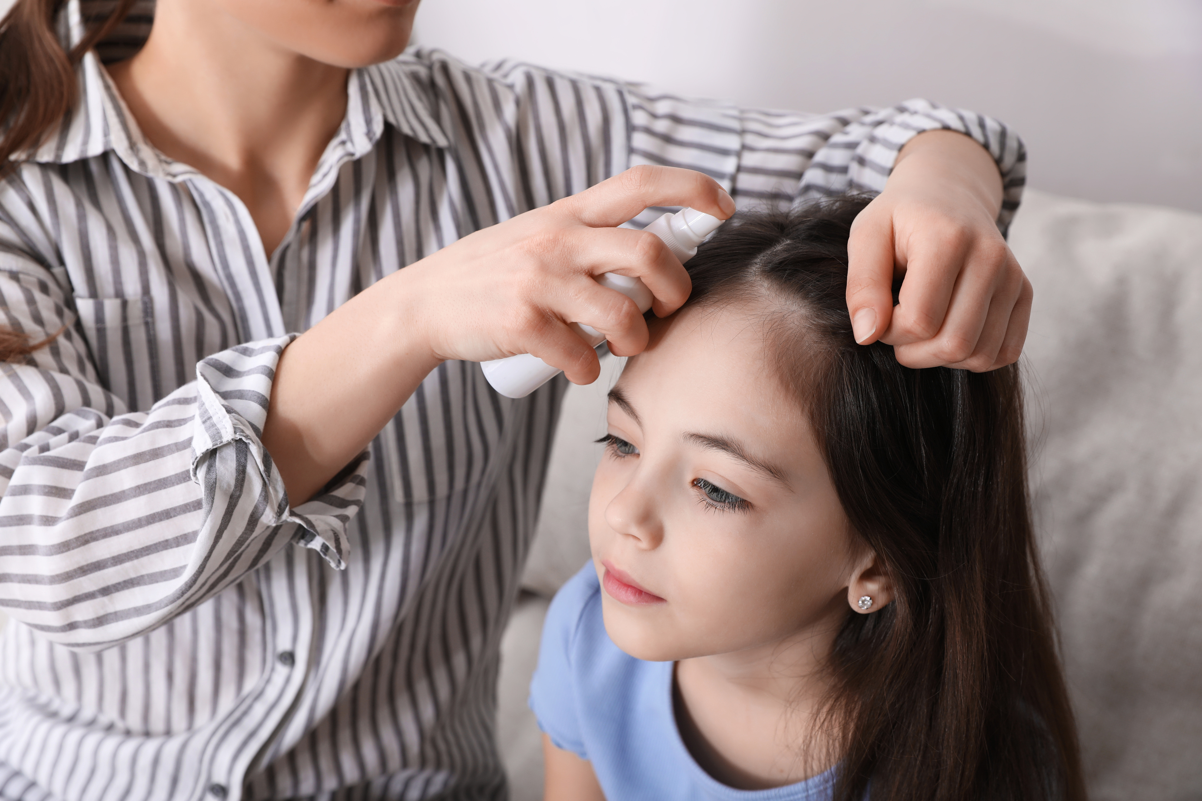
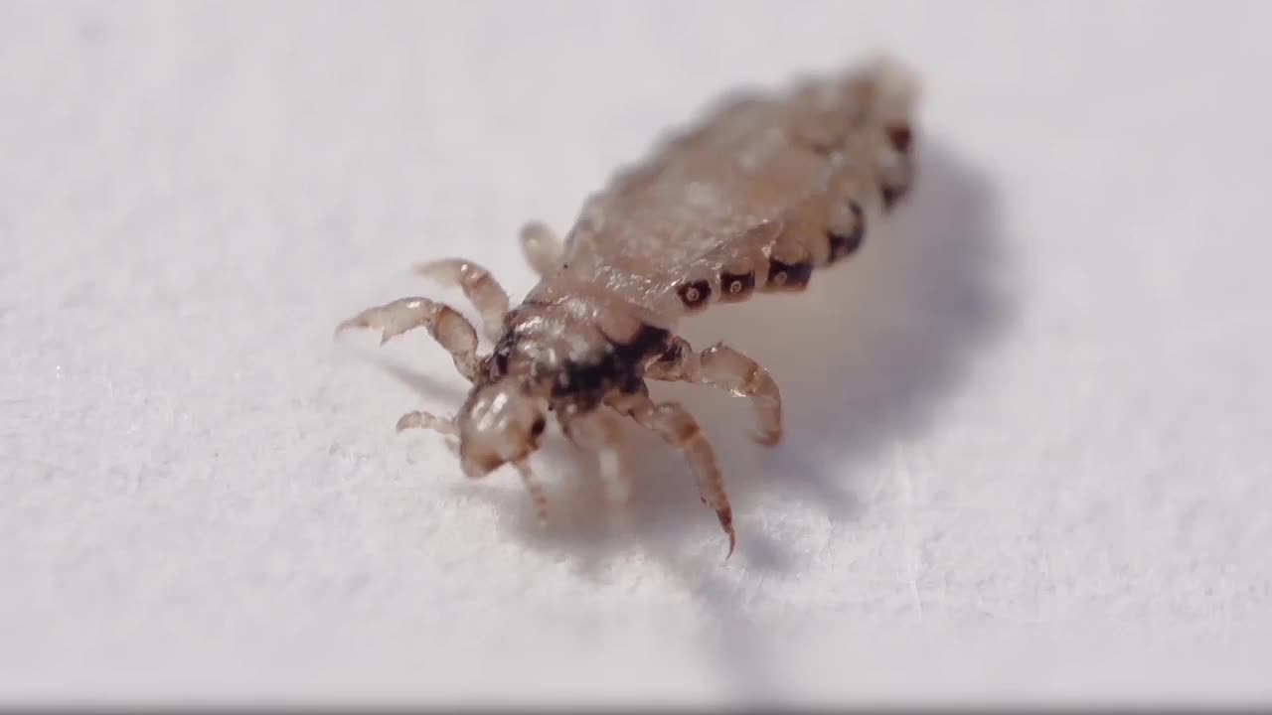
Lice don't carry disease
  Don't share hats, hair brushes or clothes
  Don't play with each others hair or hug.
Kinder & 1st Video lesson: What Causes Head Lice? Dr. Binocs
Treatment:
  Lice shampoo, comb & heat dry hair with parents help
  Clean sheets and vaccum area where you were.
  Repeat in 2 weeks
2nd Video lesson: Video: Head Lice, Cause, Signs and Symptoms, Diagnosis & Treatment

Slide 3
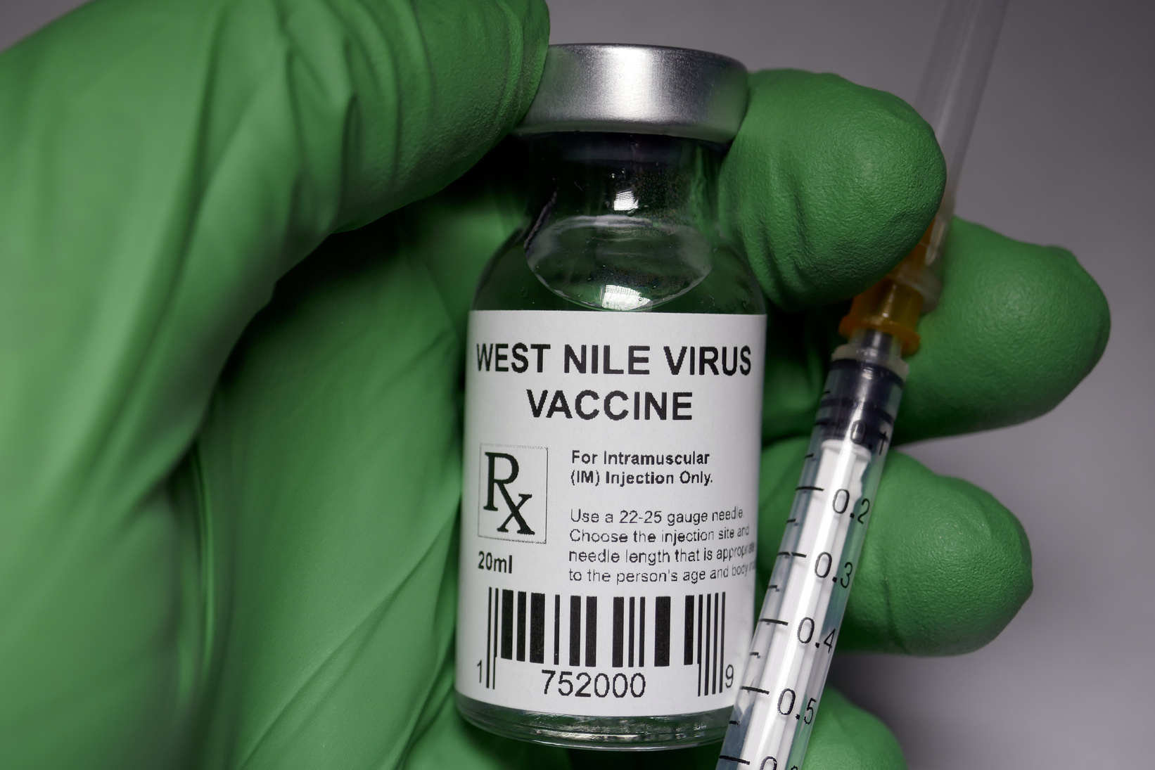
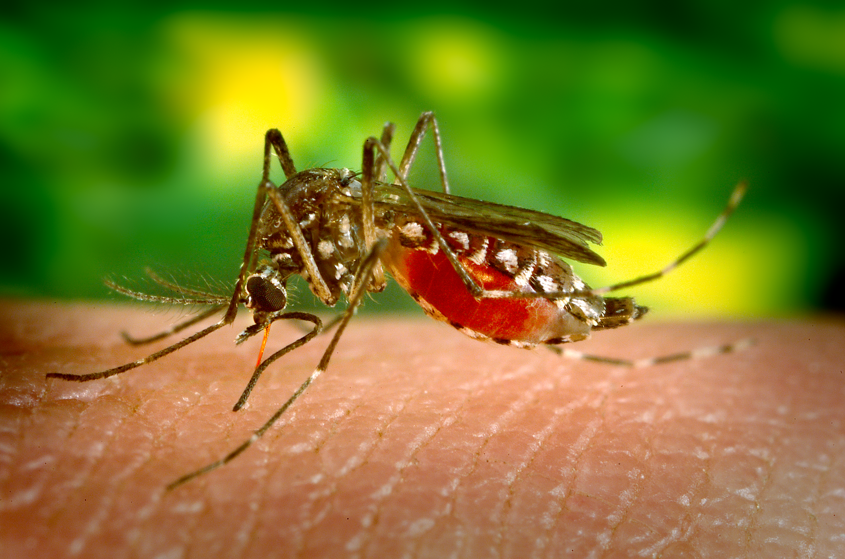

Mosquito carry West Nile in the U.S. - symptoms fever and most people recover
Prevention
  Mosquito repellant, clothing
  Vaccine if you are traveling to an area with high insident
  Oral medicine for Malaria

Slide 4
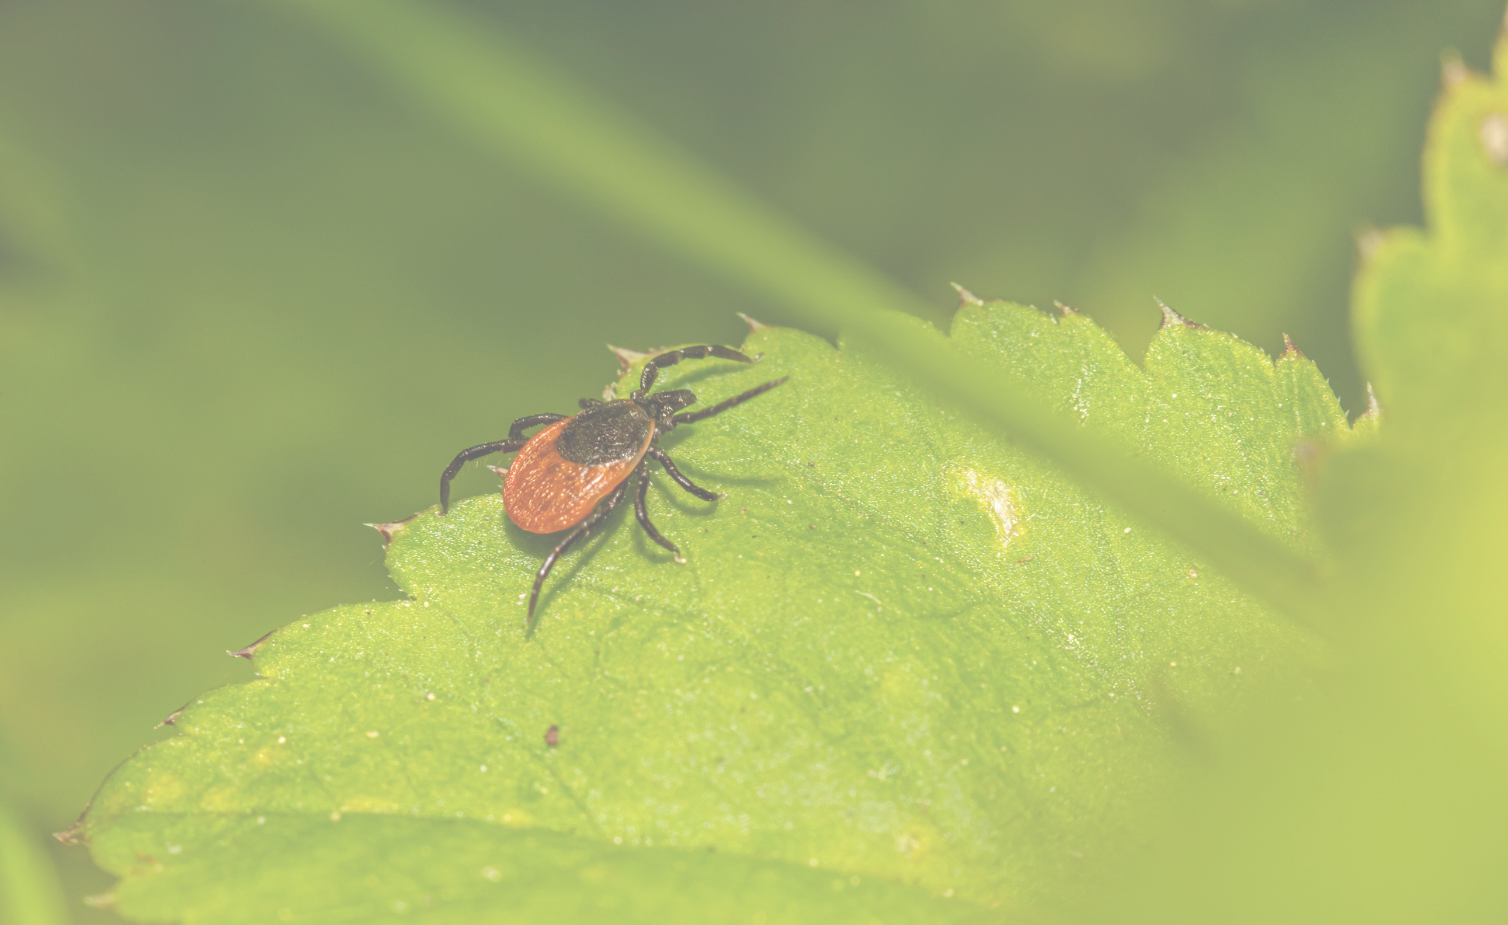
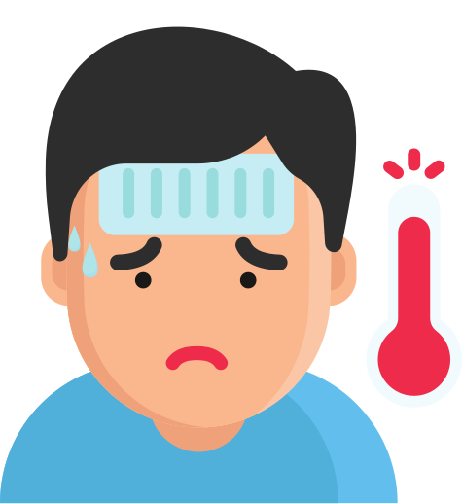
Lymes disease and
Rocky Mountain Spotted Fevert
These diseases are caused by two
different bacteria
  The tick has to be under your skin for 24 hours
  Fever, headache and nausea
  How could we prevent this if you go hiking or brush your dog?

Slide 5
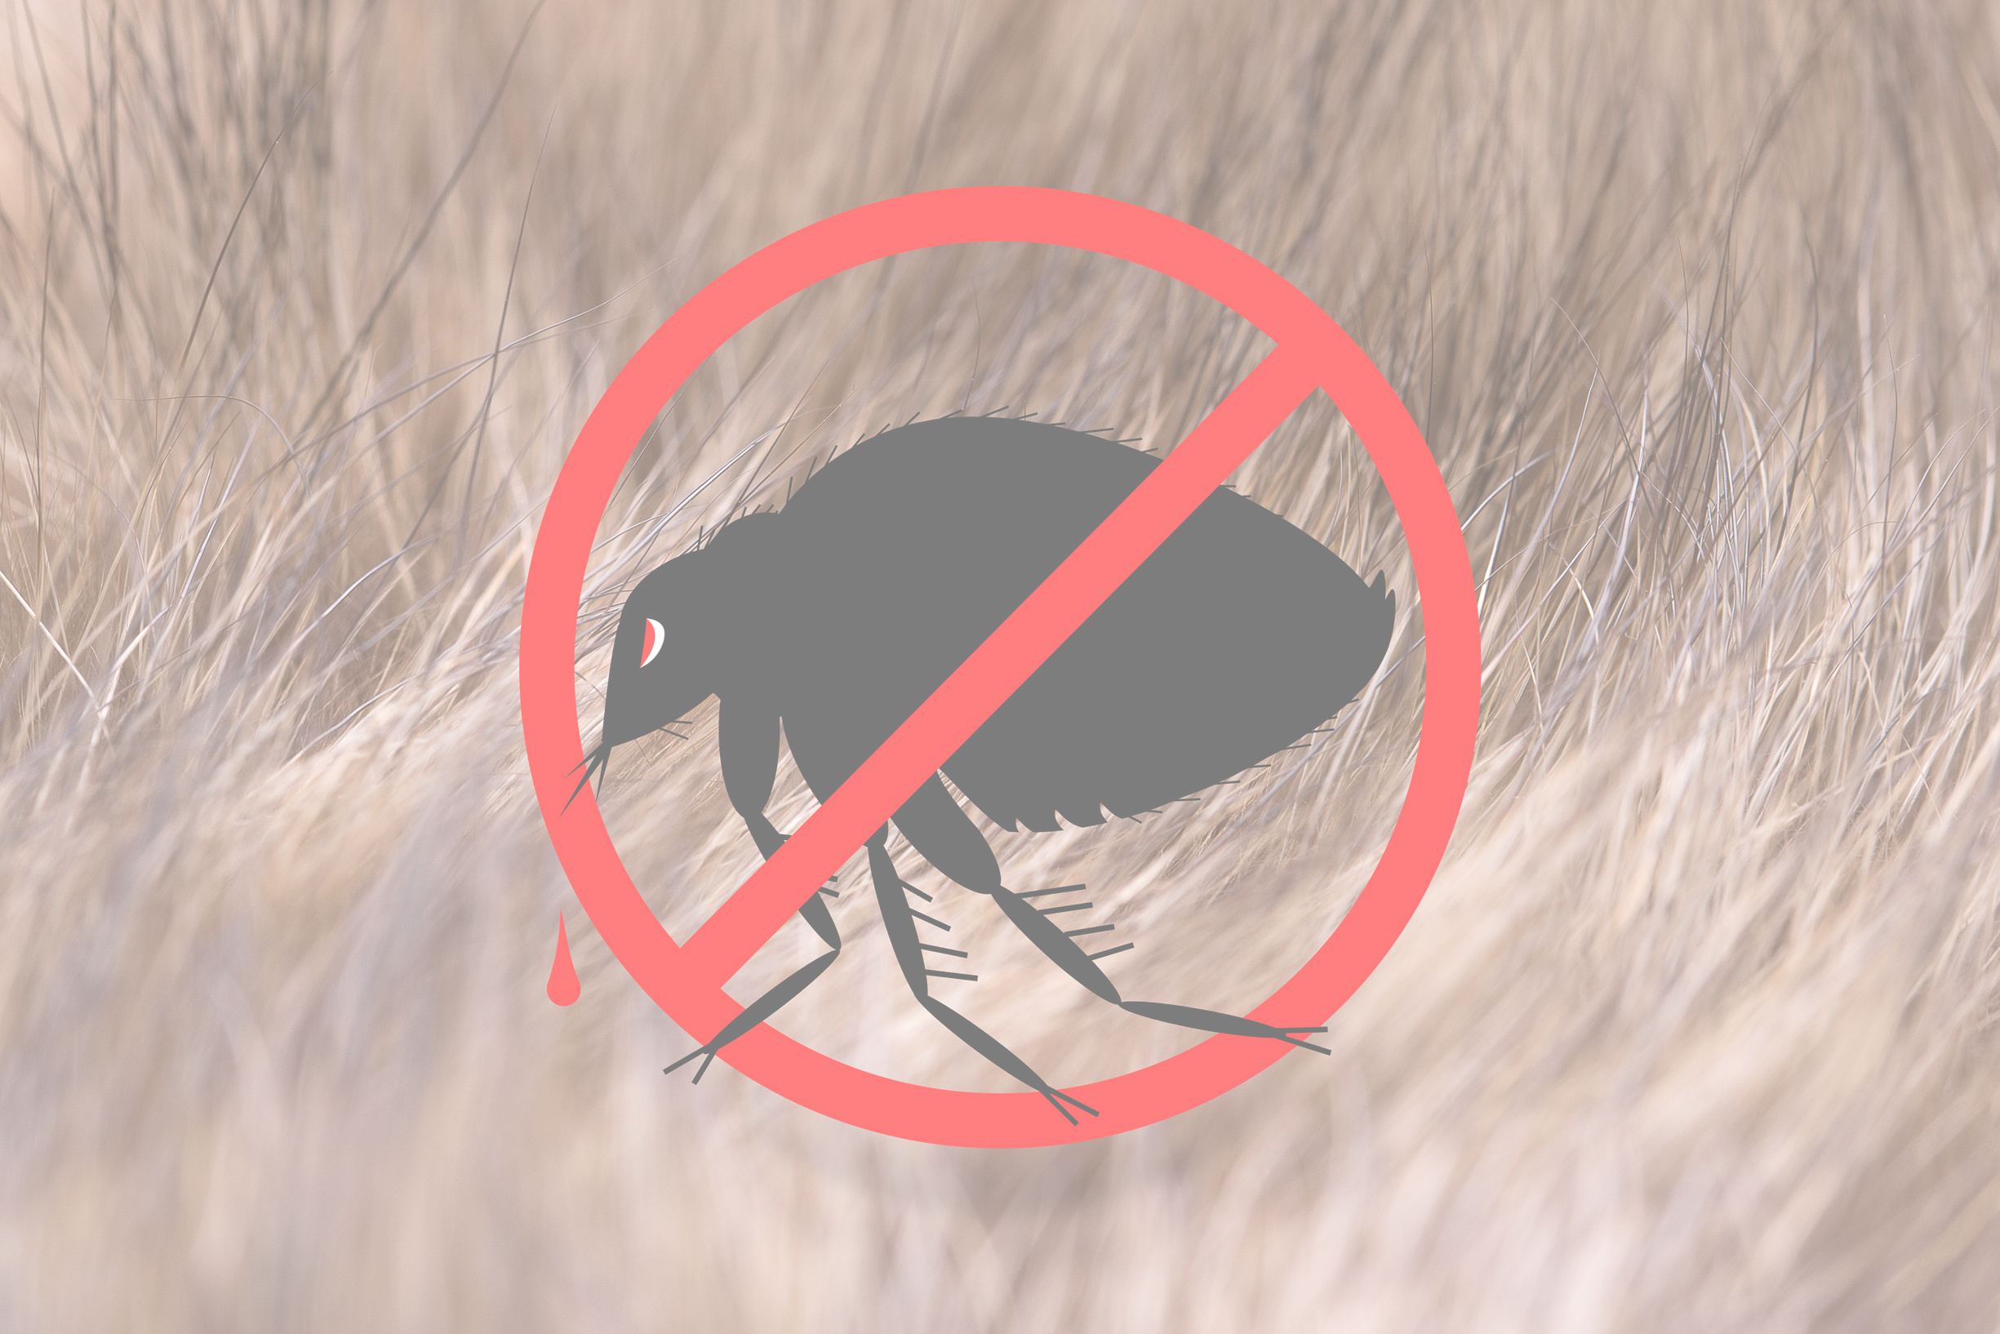

Fleas found on Rodents: rats, mice, and squirrals could carry the bacteria that causes the Plague
Prevention:
  Wear repelant when you are hiking
  Do not handle rodents.
  Treated with antibiotics
Symptoms:
Patients develop fever, chills, extreme weakness, abdominal pain, shock,

Slide 6

Animation: Companion Animal Vector-borne Diseases
Kinder - 2nd play Dead Bug p. 128
3rd -5th Play Mosquito Tag on P. 232
Book: Lesson Plans for Elementary PE
by Wendi Daniels

Slide 7

Bibliography
K-1st What Causes Heal Lice Dr. Binocs
https://www.youtube.com/watch?v=Ect-ty6ka0M&t=85s
2nd Grade HEAD LICE, Cause, Signs and Symptoms, Diagnosis and Treatment
https://www.youtube.com/watch?v=si7uTKPMVjw&t=1s
2nd-5th grade: Animation: Companion Animal Vector-Borne- Diseases
https://www.youtube.com/watch?v=q1P3QupjhYo&t=4s
Mosquito Tag p.232 in the book or Revolutionary PE Channel https://www.youtube.com/watch?v=IS90YVCiBOI

